Slide 1
Deep Learning
Overview of Supervised Learning

Slide 2
Introduction to Supervised Learning
Supervised Learning is a type of Machine Learning in which a model learns from a dataset containing both:
  Input data (features)
  Correct output (target/label)
The objective is to learn a mapping between input and output so that the trained model can predict the correct output for new, unseen data.

Slide 3
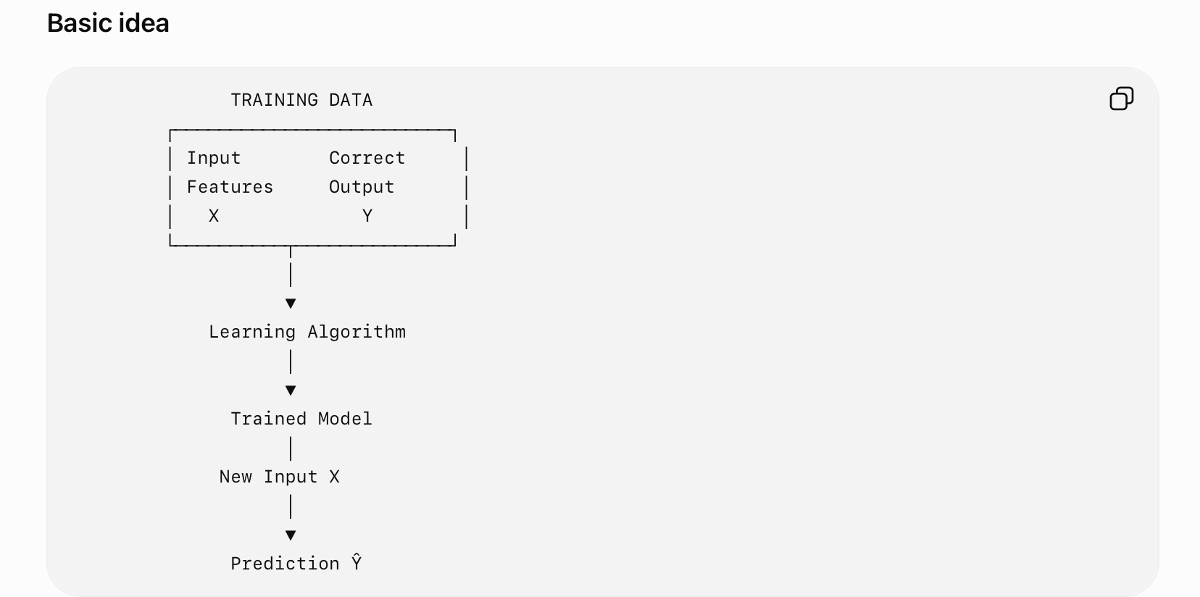
Basic Working of Supervised Learning

Slide 4
Mathamatical Representation
Mathematically, supervised learning attempts to learn:
Y = f(X)
where:
  (X) = input/features
  (Y) = actual output/target
  (f) = function learned by the model
For a new input \(X_{new}\):
{Y}=f(X_{new})

Slide 5
Component of Supervised Learning
1. Input Feature
2. Target/ Label
3. Training Dataset
4. Model
5. Loss Function
6. Learning/ Optimization

Slide 6
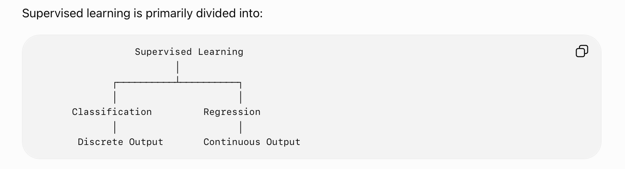
Types of Supervised Learning

Slide 7
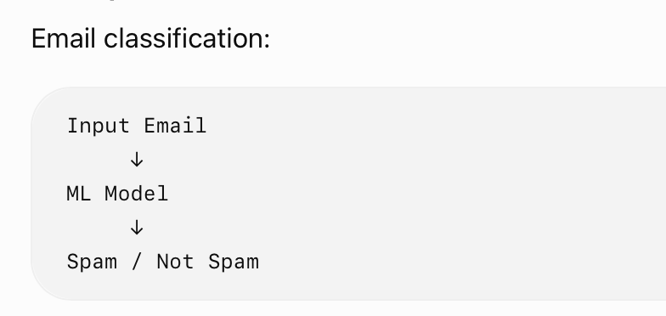
A. Classification
Classification predicts a categorical/discrete output.
  three examples:
  Disease / No Disease
  Cat / Dog
Types of Classification :
  1. Binary Classification
  2. Multi-Class Classification

Slide 8
B. Regression
Regression predicts a continuous numerical value.
Examples:
  House price prediction
  Temperature prediction
  Stock-price estimation
  Sales forecasting
For example:
  Input rightarrow Model rightarrow ₹75,42,000
  The output is not simply one of a fixed set of classes.

Slide 9
Supervised Learning Process
1. Collect Data
2. Prepare Data
3. Split Dataset - Testing Dataset, Validation Dataset, Training Dataset
4. Train Model
5. Calculate Loss
6. Update Parameters
7. Test Model

Slide 10
Advantages
Uses known target outputs for learning.
Performance can be quantitatively evaluated.
Useful for prediction and classification.
Can solve complex real-world problems.
Deep neural networks can automatically learn complex relationships from large datasets.

Slide 11
Disadvantages
Requires labelled training data.
Preparing labelled data can be expensive and time-consuming.
Poor-quality labels can produce poor models.
Models can overfit the training data.
Performance depends strongly on the quality and representativeness of the training data.

Slide 12
Fundamental of Neural Network& Deep Learning
1.2

Slide 13
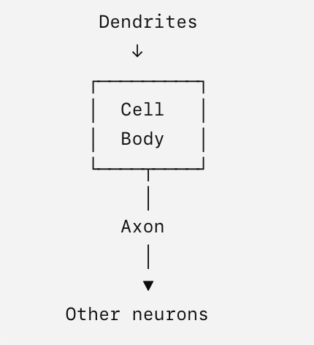
FUNDAMENTAL OF NN & DL
What is a Neural Network?
An Artificial Neural Network (ANN) is a computational model inspired by the structure and functioning of biological neural networks.
It consists of interconnected computational units called neurons.
A neural network learns a relationship between inputs and outputs by adjusting its internal parameters, primarily weights and biases.
Biological Neuron
The artificial neuron was inspired by the biological neuron.
A biological neuron approximately consists of:

Slide 14
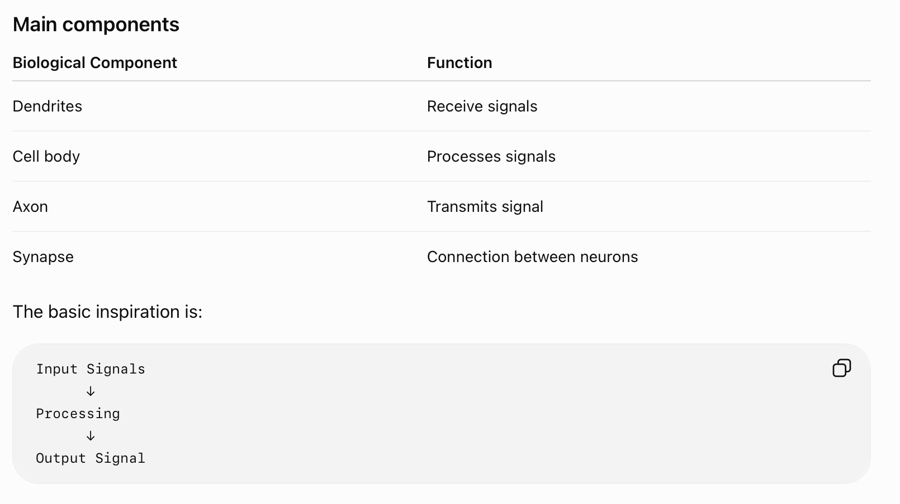

Slide 15
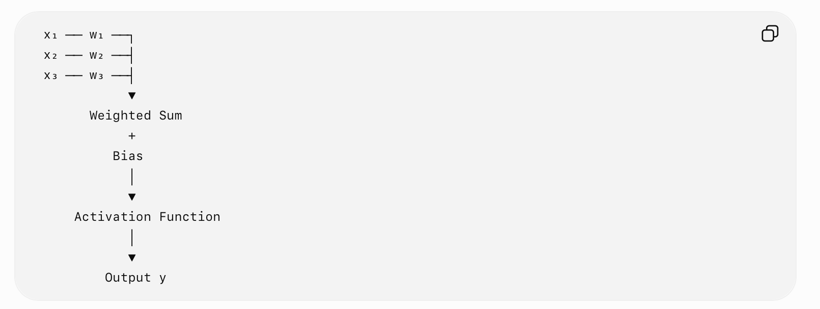
Artificial Neuron
An artificial neuron receives multiple inputs, applies weights, adds a bias, and passes the result through an activation function.

Slide 16
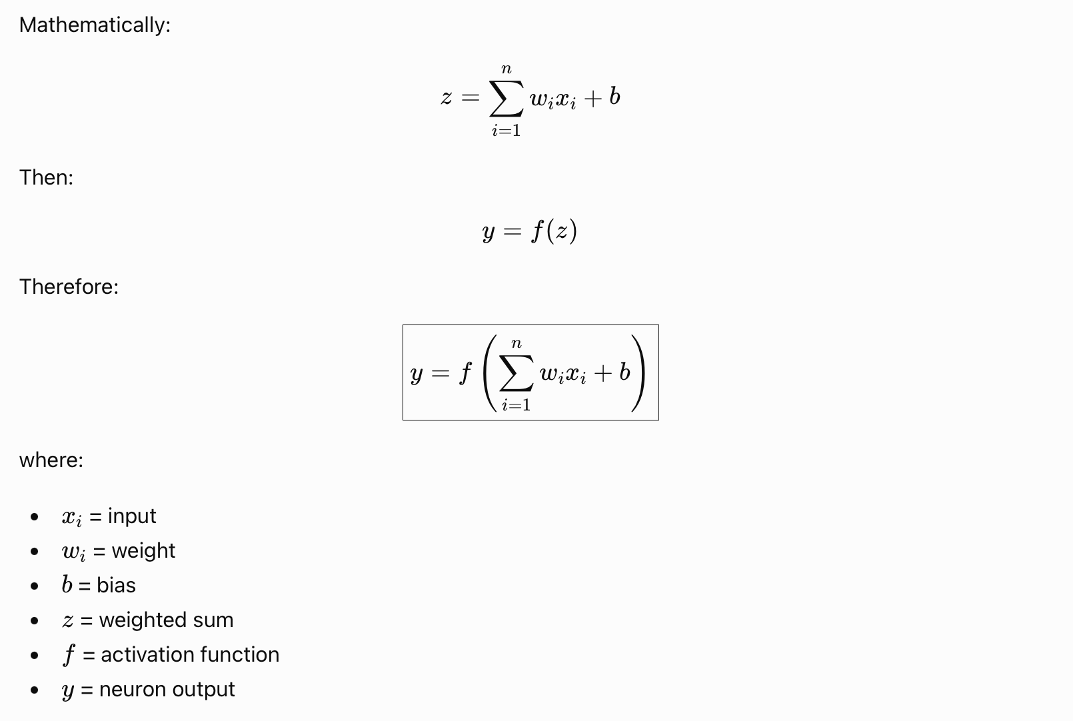
Mathematical Representation

Slide 17
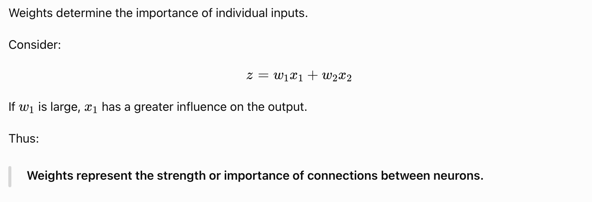
Role of Weights

Slide 18
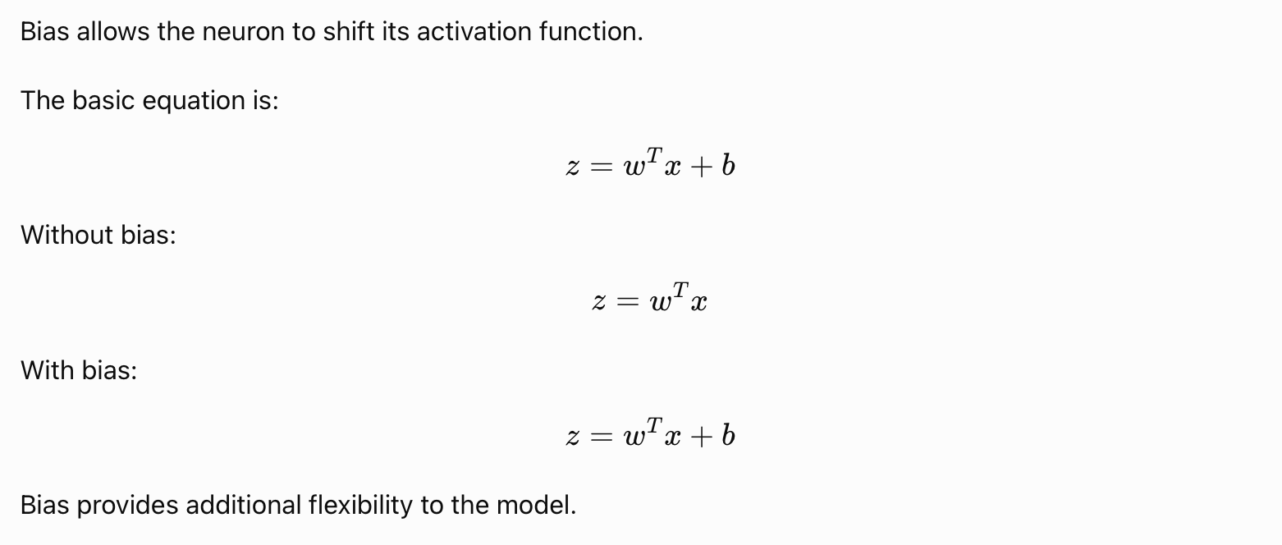
Role of Bias

Slide 19
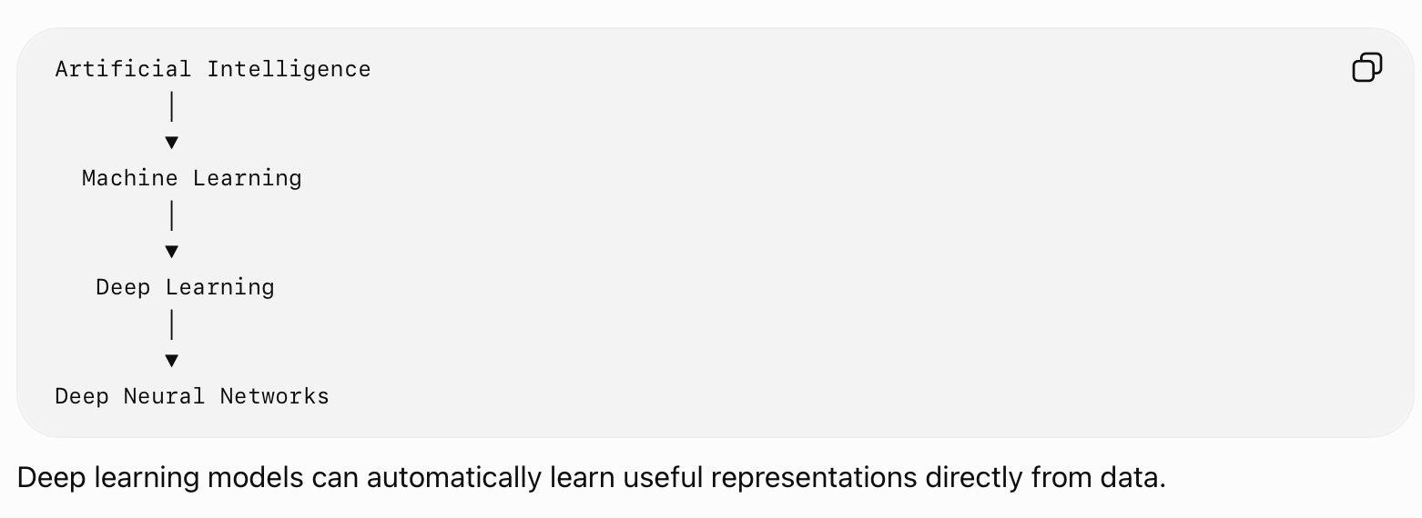
What is Deep Learning?
Deep Learning is a subfield of Machine Learning that uses neural networks containing multiple layers to learn increasingly complex representations of data.
A simple conceptual hierarchy is:

Slide 20
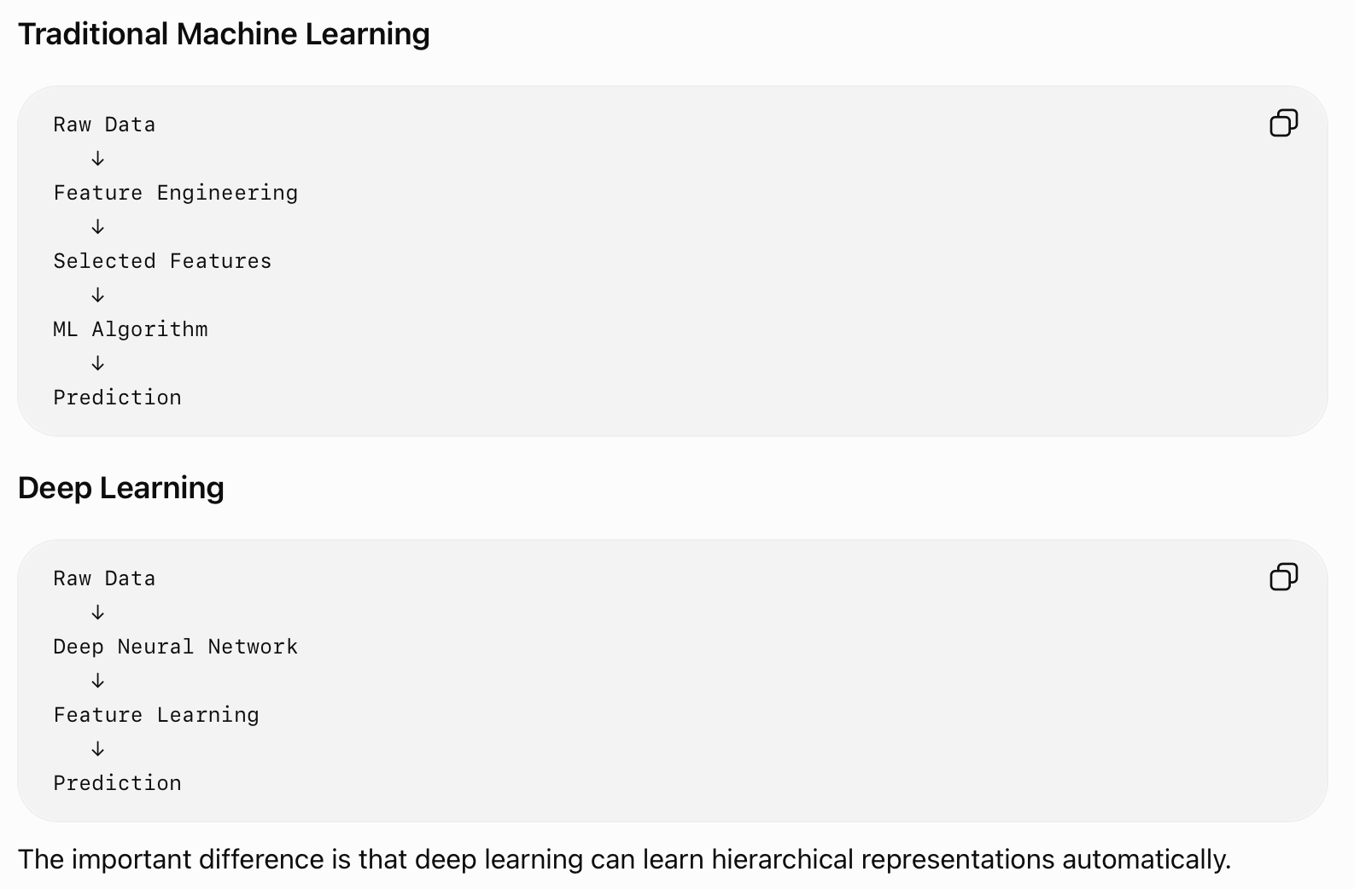

Slide 21
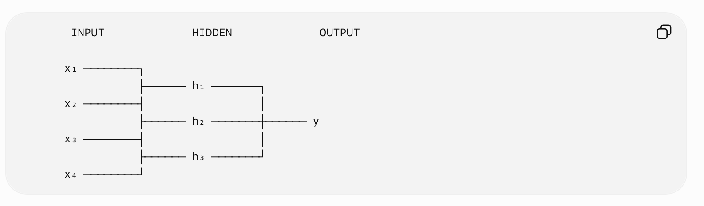
Neural Network Architecture
A basic neural network consists of:
  Input layer
  Hidden layer(s)
  Output layer

Slide 22
Layers Information
Input Layer
  Receives input features.
  For example, if an image/data sample is represented using 100 features, the input layer can have 100 input units.
Hidden Layer
  Hidden layers perform transformations on the input.
  A network can contain:
  One hidden layer
  Several hidden layers
  Hundreds of layers in modern architectures

Slide 23
Layers Information
Output Layer
  Produces the final prediction.
  For example:
  Binary classification
  One output neuron can represent the probability of one class.
  Multiclass classification
  Multiple output neurons can represent different classes.

Slide 24
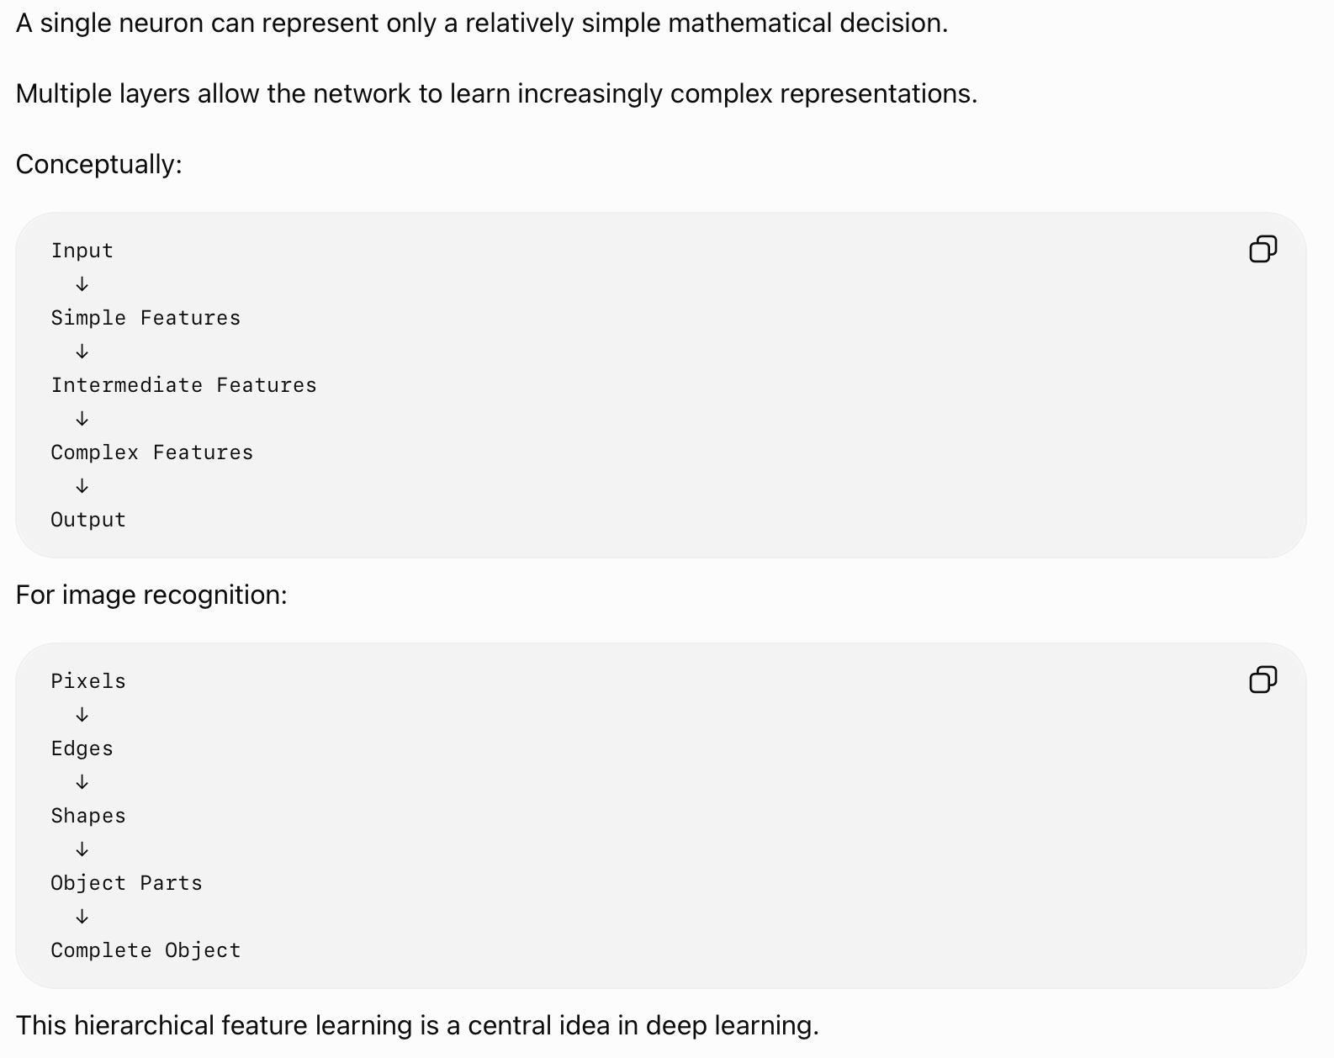
Multiple
Layers

Slide 25
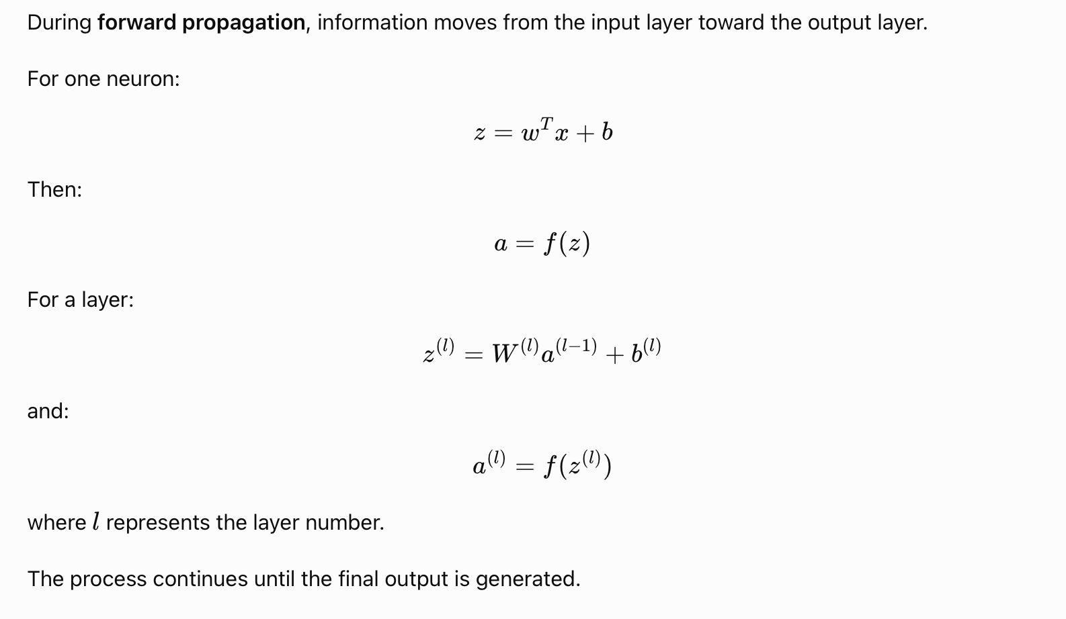
Forward Propagation

Slide 26
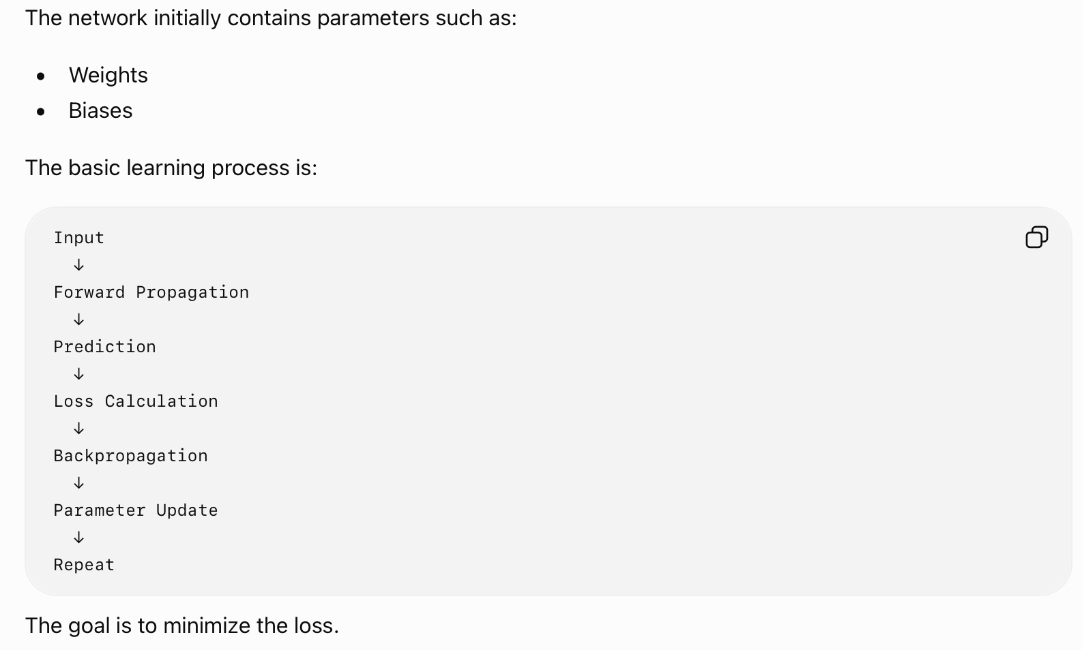
Learning of NN

Slide 27
Application of DL
Computer Vision
NLP
Speech
Healthcare
Autonomuous System

Slide 28
Vector & Calculus
1.3

Slide 29
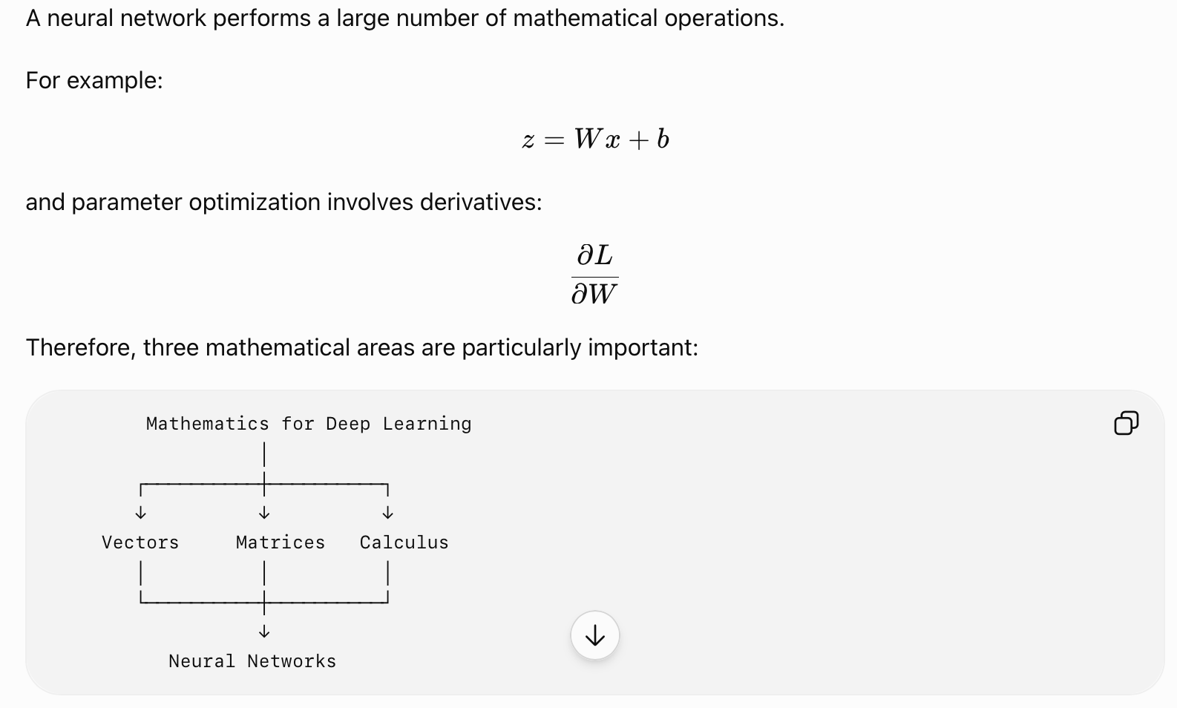
Why Mathematics is Required in Deep Learning?

Slide 30
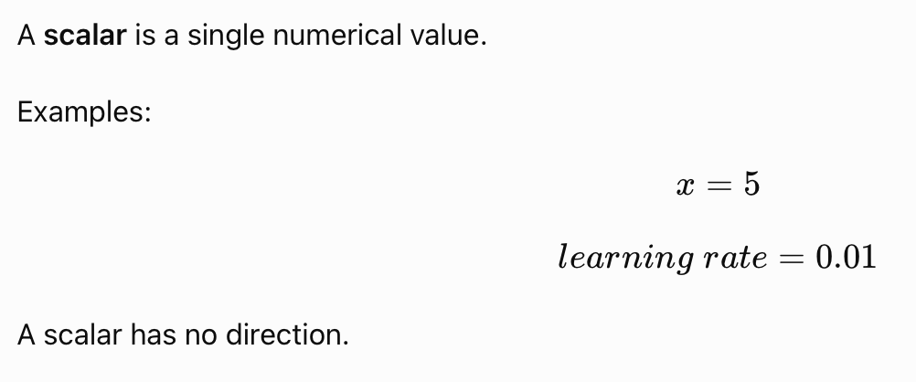
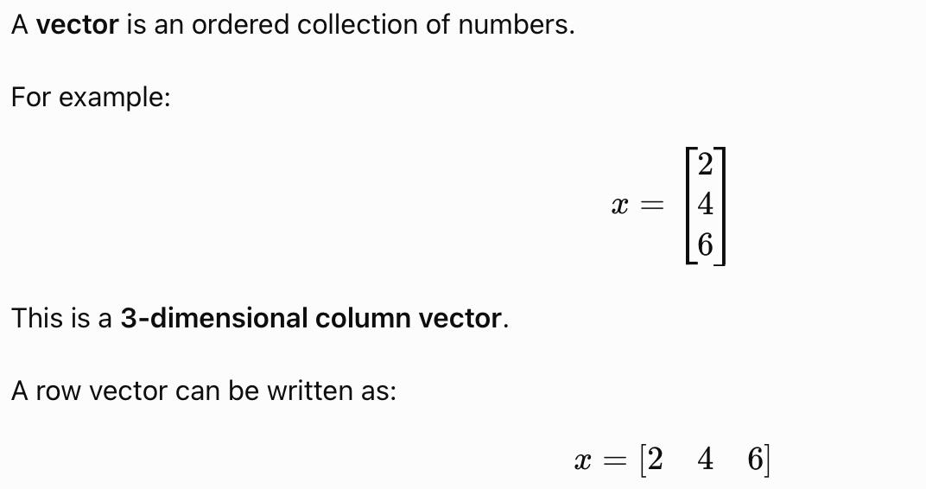
Scalar & Vector

Slide 31
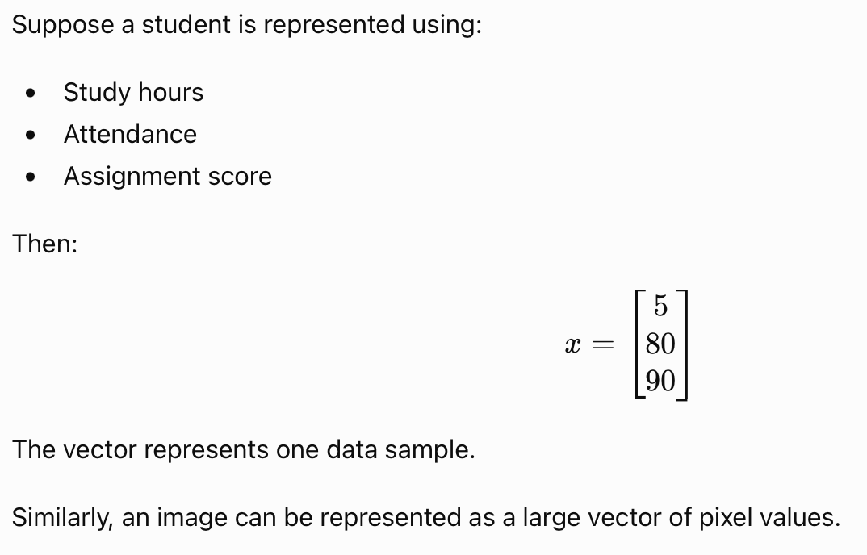
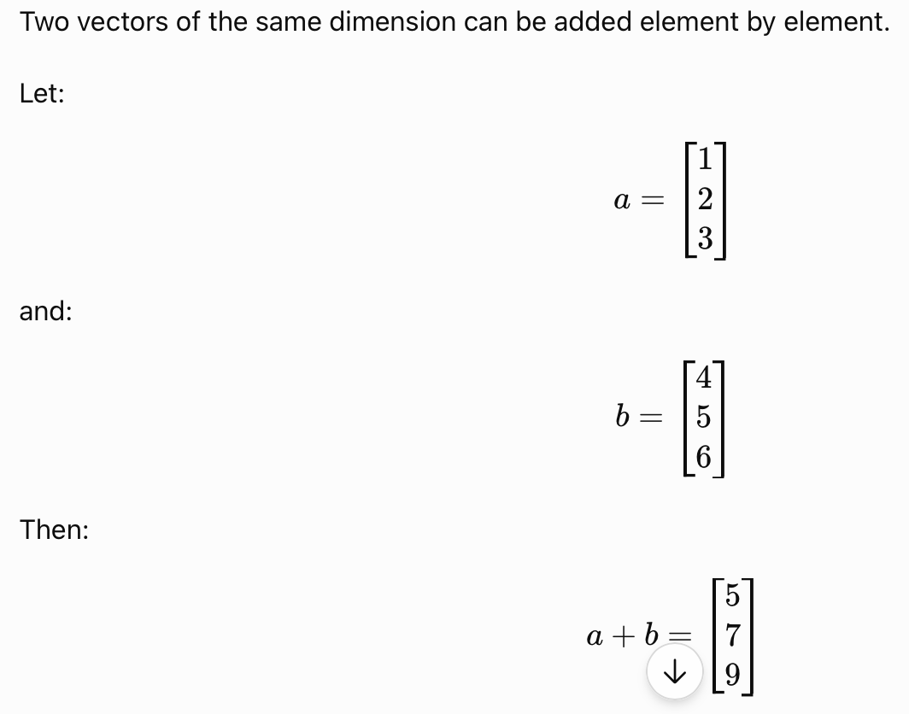
Vector

Slide 32
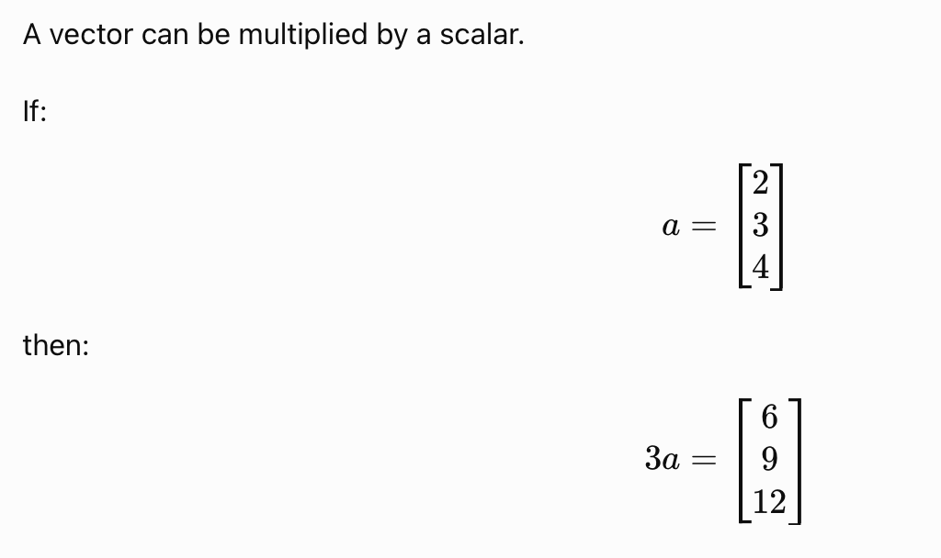
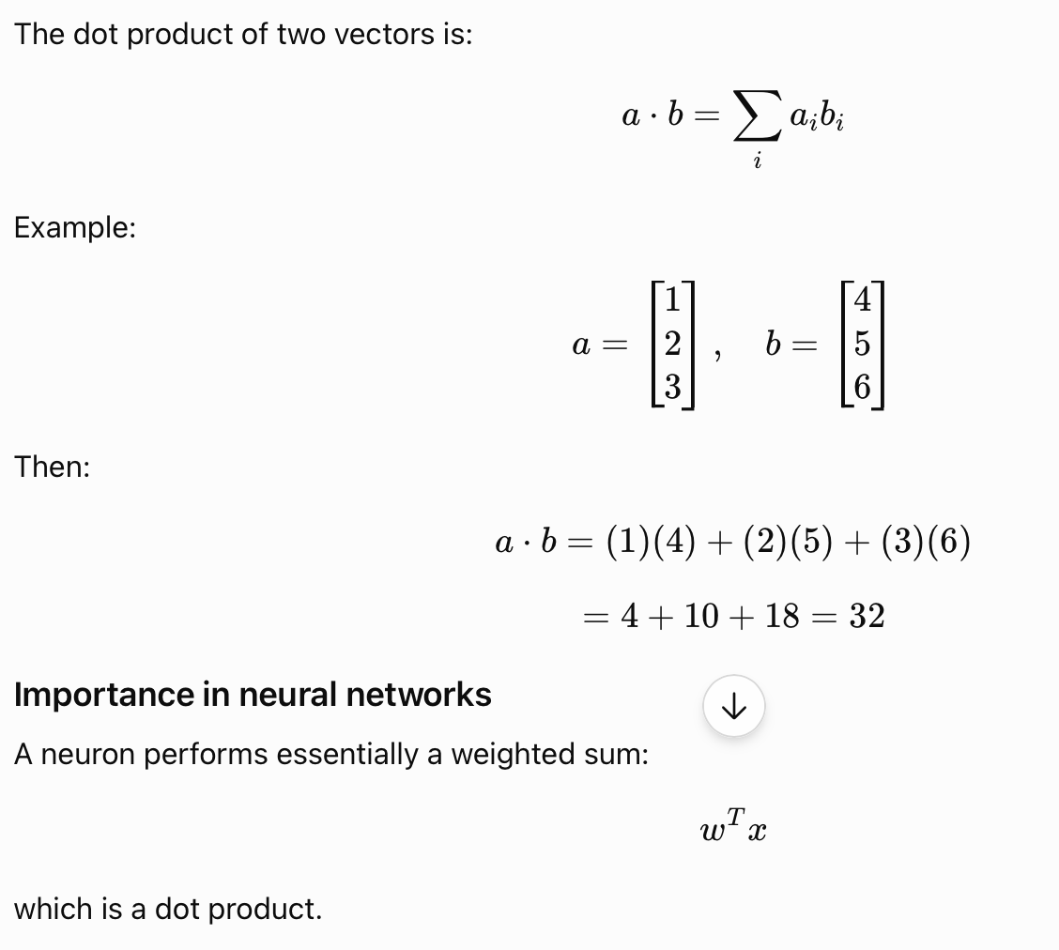
Scaler Addition &
Dot Product

Slide 33
Biological Neuron
1.4

Slide 34
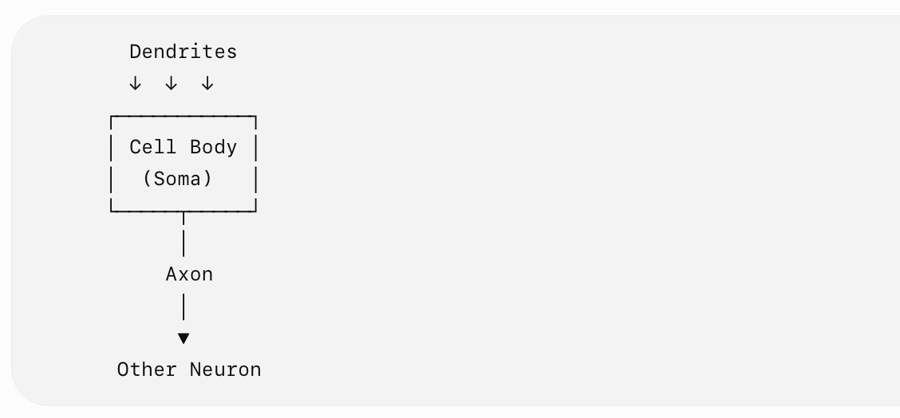
Biological Neuron
A biological neuron is the basic functional unit of the human nervous system. It receives signals, processes them, and transmits signals to other neurons.

Slide 35
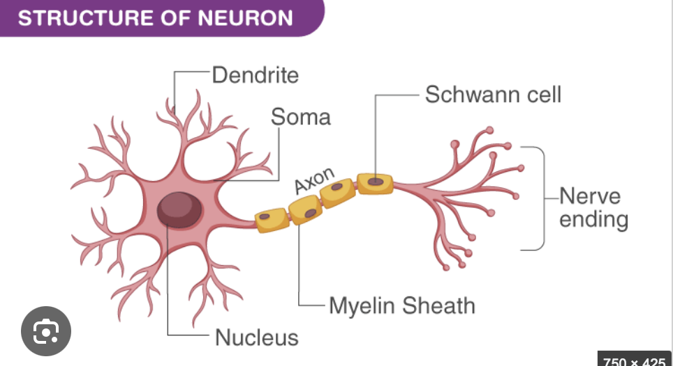
Basic Stucture of Biological Neuron

Slide 36
Components
Main Components
Component Function
Dendrites Receive signals from other neurons
Cell body (Soma) Processes incoming signals
Axon Carries electrical signals away from the cell body
Synapse Connection through which signals are transmitted to another neuron

Slide 37
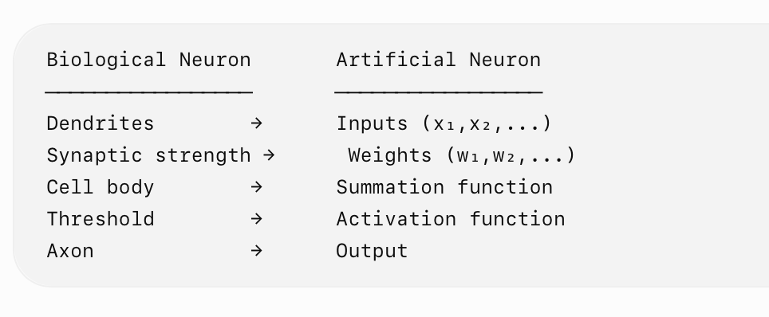
Working
Dendrites receive input signals.
Signals are transmitted to the cell body.
The neuron processes the received signals.
If the signal reaches the required threshold, the neuron generates an electrical impulse.
The impulse travels through the axon.
The signal is transmitted to another neuron through a synapse.
Relation to Artificial Neuron

Slide 38
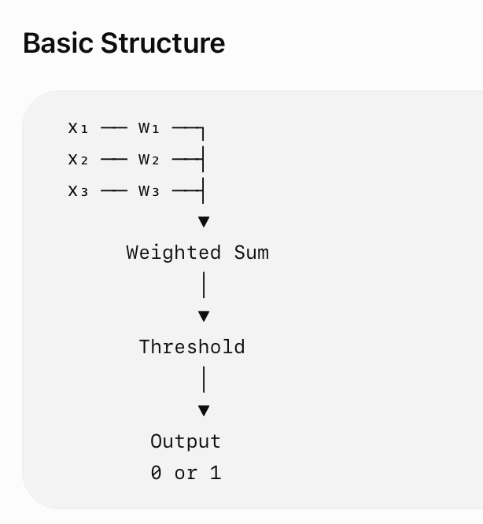
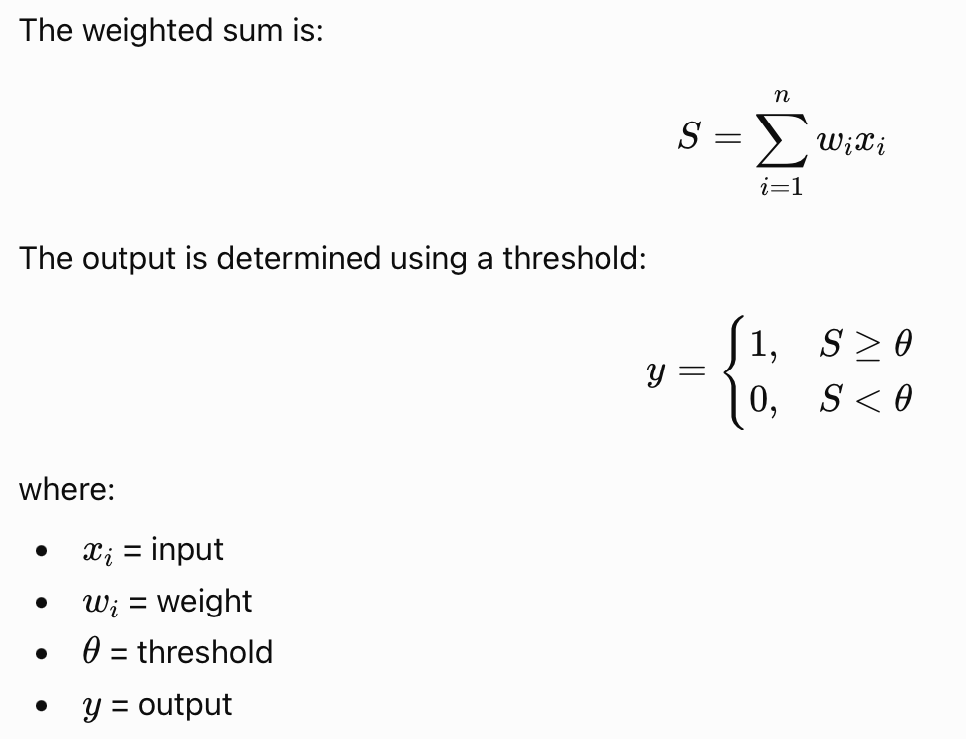
McCulloch–Pitts Neuron
The McCulloch–Pitts (M-P) neuron is one of the earliest mathematical models of an artificial neuron, proposed by Warren McCulloch and Walter Pitts.
It uses a set of inputs, weights, a summation operation, and a threshold-based output.

Slide 39
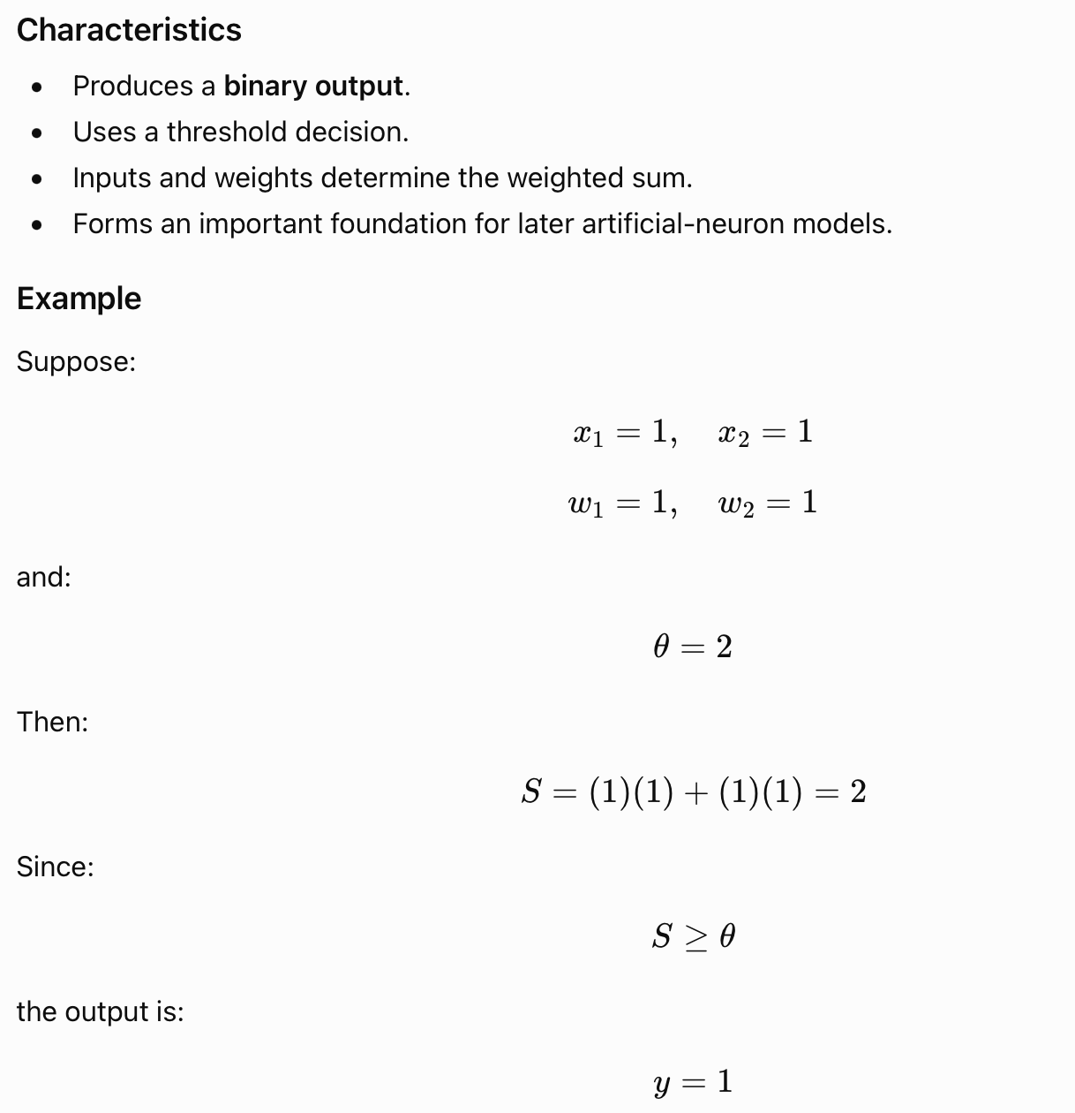

Slide 40
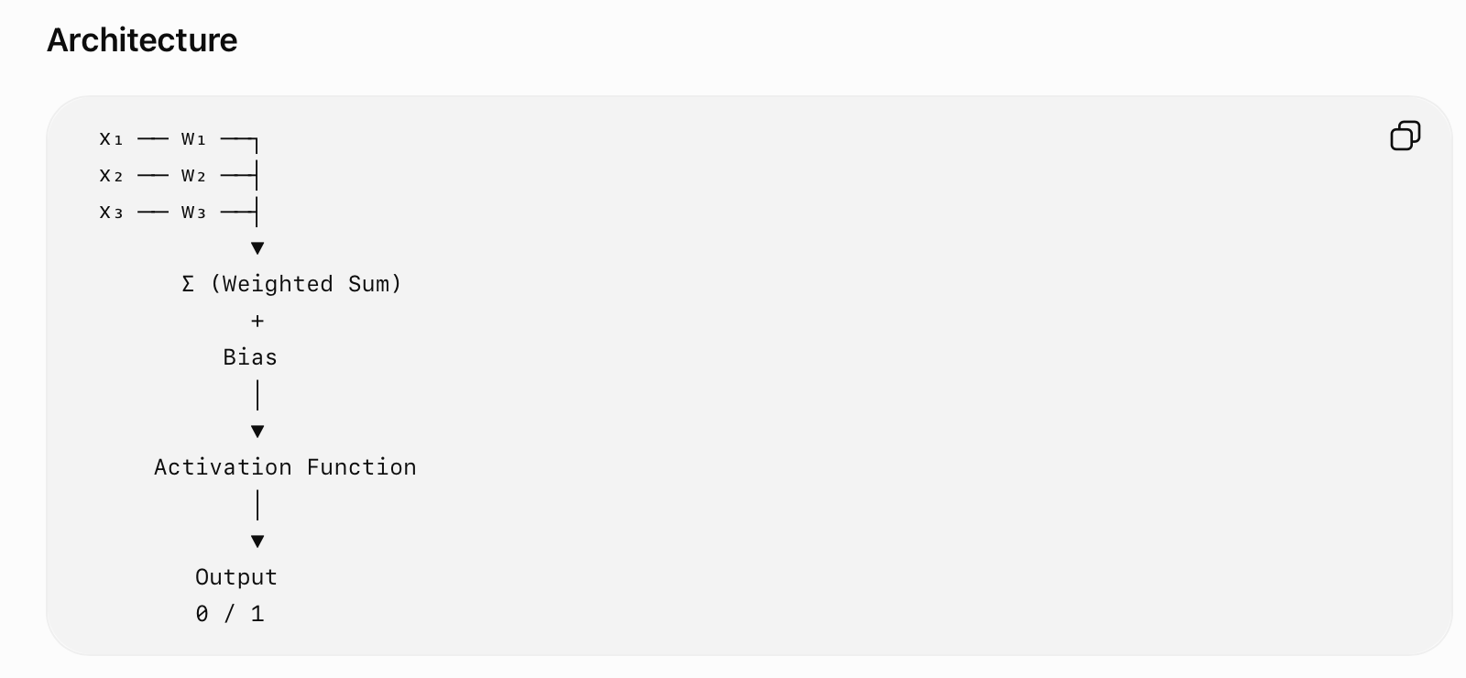
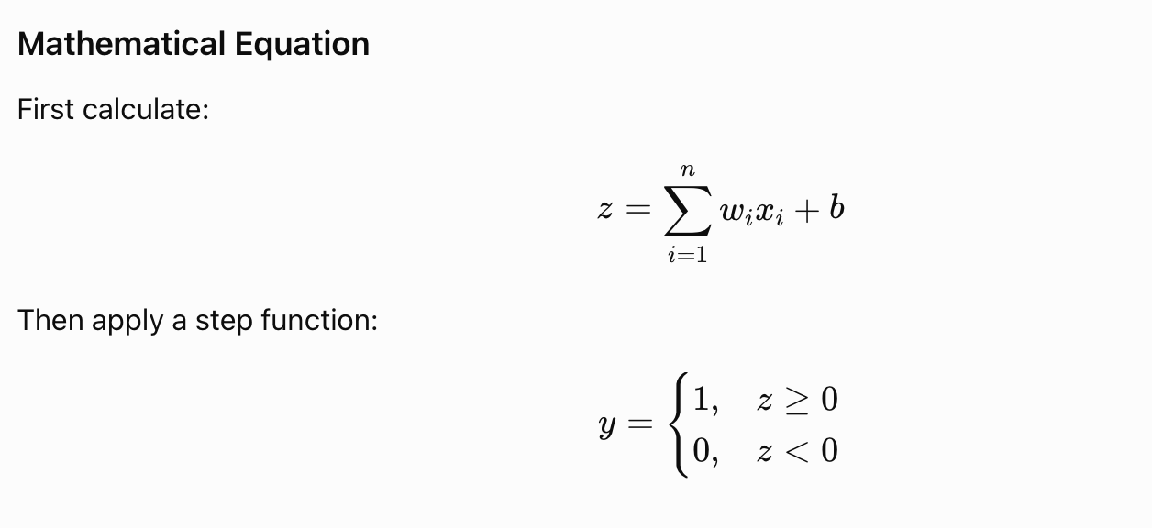
Percptron
The Perceptron is a basic artificial neural-network model used primarily for binary classification.
It can be considered an extension of the threshold-based artificial neuron with learnable weights.

Slide 41
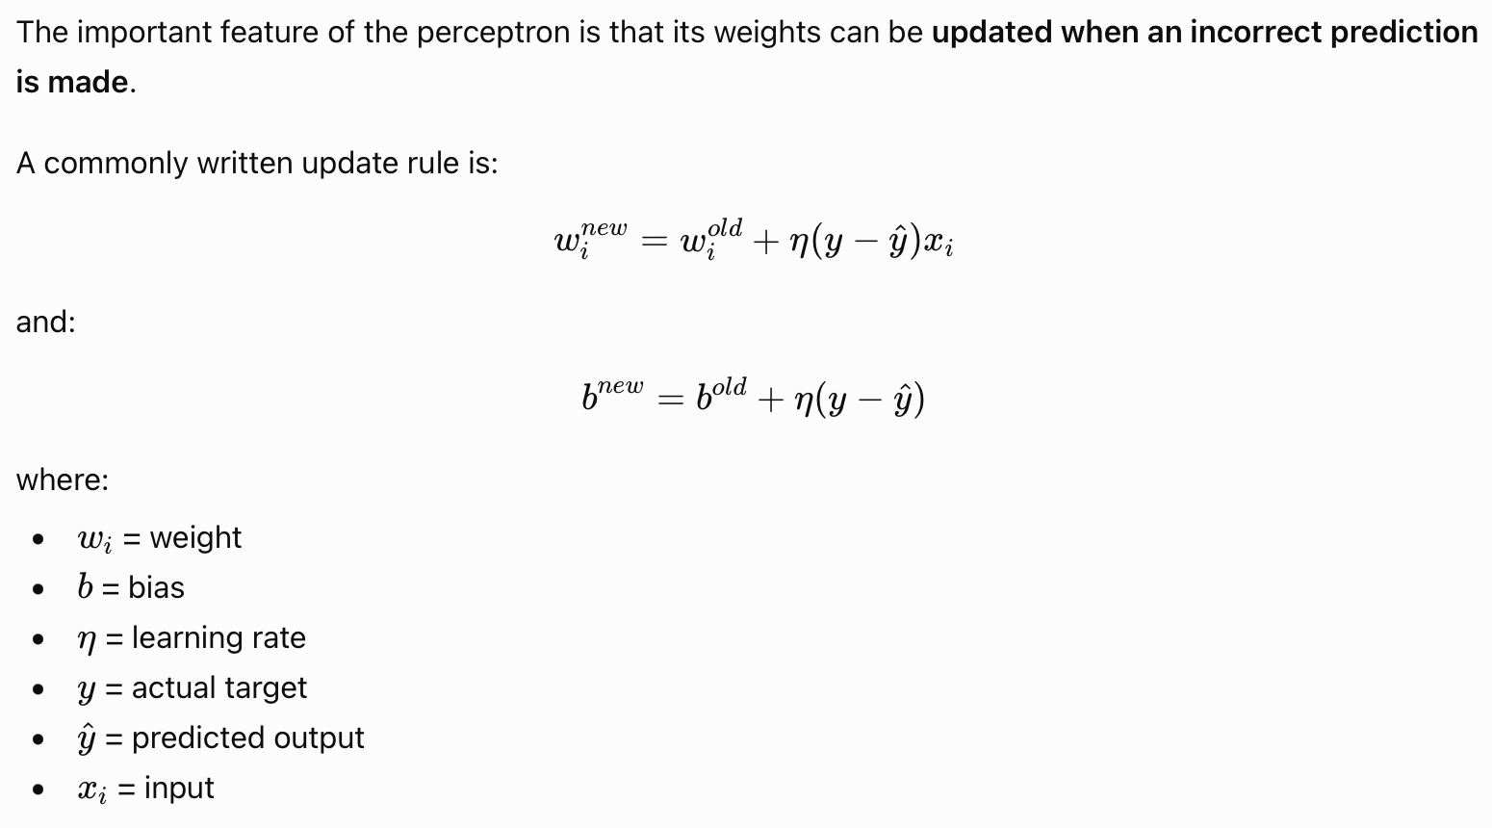
Perceptron Learning

Slide 42
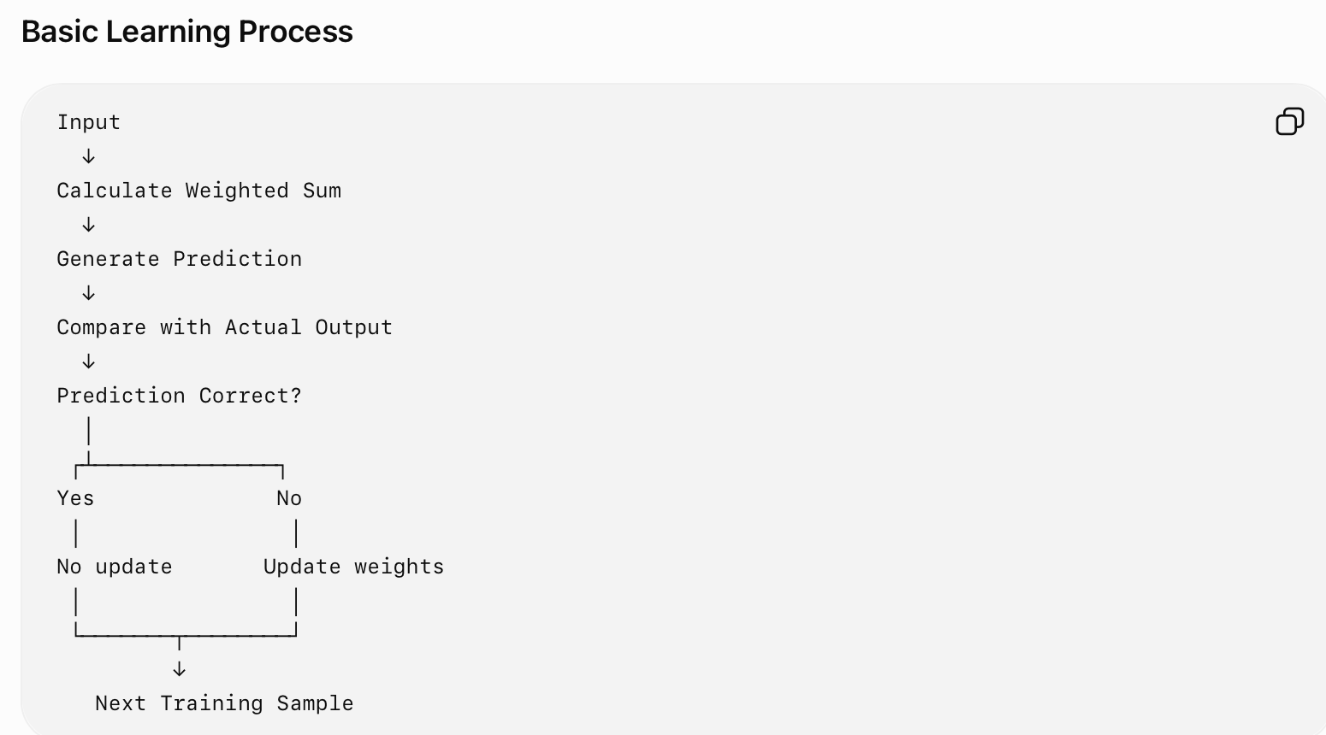
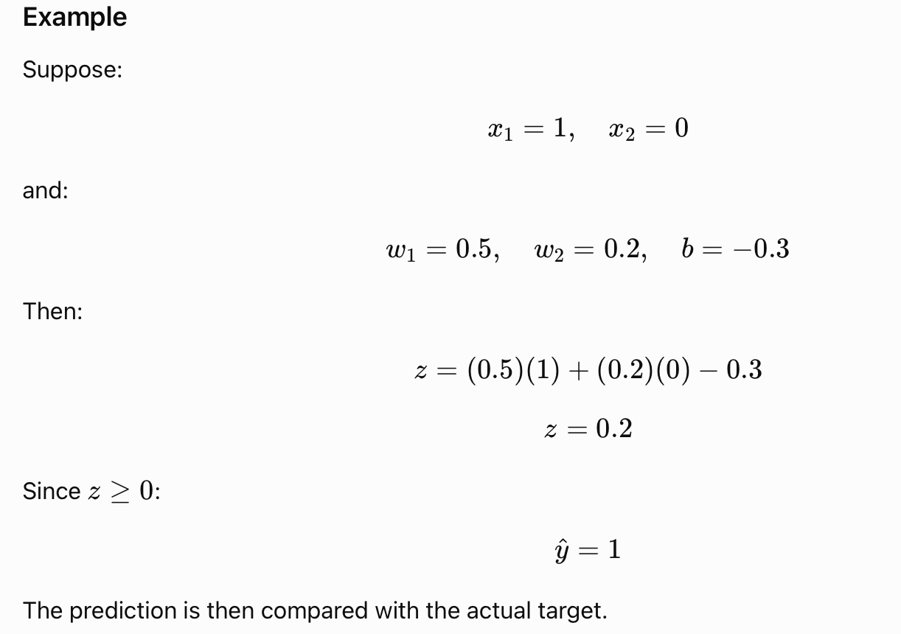
Basic Learning Process

Slide 43
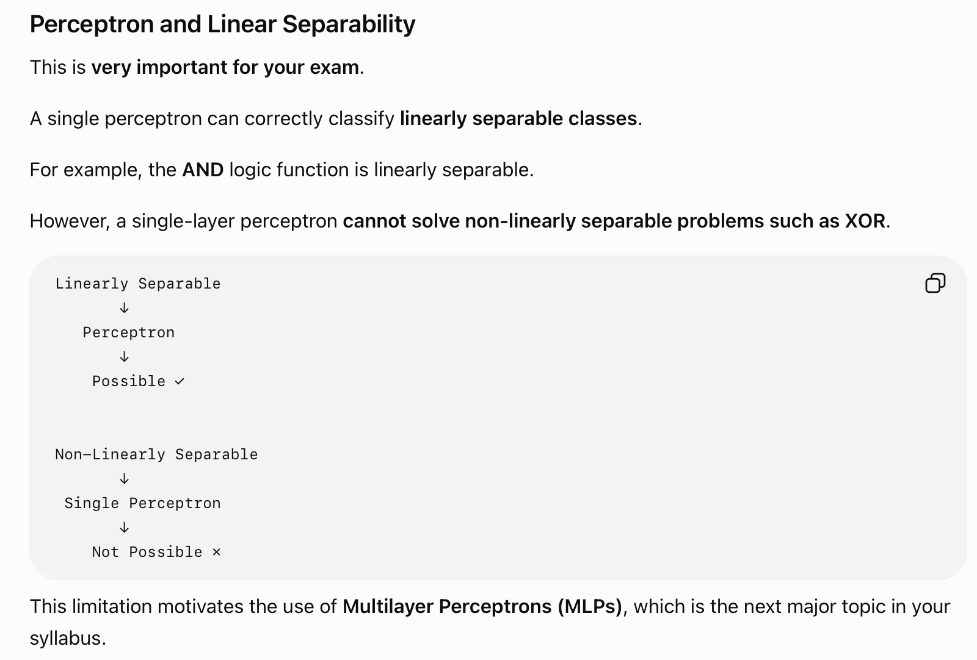

Slide 44
Quick Comparision
Feature | Biological Neuron | M-P Neuron | Perceptron
Nature | Biological | Mathematical model | Learning model
Input | Signals | Binary inputs | Numerical inputs
Weights | Synaptic strength | Fixed/defined weights | Learnable weights
Decision | Biological process | Threshold | Activation/threshold
Output | Electrical signal | Usually 0/1 | Usually 0/1
Learning | Biological learning | No learning mechanism | Learns weights
Main purpose | Neural communication | Model neuron | Binary classification

Slide 45
Machine Learning vs Deep Learning
1.5

Slide 46
Basis | Machine Learning (ML) | Deep Learning (DL)
Definition | A subset of AI that enables systems to learn patterns from data and make predictions. | A subset of ML that uses multi-layer neural networks to learn complex patterns.
Feature Engineering | Usually requires manual feature selection and engineering. | Can automatically learn relevant features from raw data.
Data Requirement | Can work effectively with relatively smaller datasets. | Generally benefits from large amounts of data.
Architecture | Uses algorithms such as Decision Trees, SVM, Random Forest, KNN, etc. | Primarily uses deep neural-network architectures.
Number of Layers | Usually does not involve many neural-network layers. | Uses multiple hidden layers.
Feature Extraction | Often performed manually or using separate techniques. | Usually learned automatically during training.
Data Types | Particularly effective with structured/tabular data. | Particularly powerful for unstructured data such as images, audio and text.
Training Time | Generally requires less training time. | Usually requires more computational time and resources.
Computational Power | Can often run effectively on CPUs. | Often benefits from GPUs/TPUs for large models.
Interpretability | Many traditional ML models can be easier to interpret. | Deep neural networks are generally more difficult to interpret.
Performance with Large Data | Performance may plateau depending on the algorithm and features. | Often improves significantly with larger datasets and appropriate architectures.
Examples | Linear Regression, Logistic Regression, Decision Tree, SVM, Random Forest. | CNN, RNN, LSTM, Transformers, Deep Neural Networks.
Applications | Credit scoring, spam detection, forecasting, tabular classification. | Image recognition, speech recognition, NLP, medical-image analysis, generative AI.

Slide 47
Additional Definition
1.6

Slide 48
Definitions
1. Keras
Keras is a high-level deep learning API used to build and train neural networks. It provides a simple and user-friendly interface for developing models such as CNNs, RNNs, and other neural networks.
2. TensorFlow
TensorFlow is an open-source machine learning and deep learning framework used to develop, train, and deploy neural-network models. It supports numerical computation and efficient execution on CPUs, GPUs, and other hardware.

Slide 49
Definitions
3. SciPy
SciPy is an open-source Python library used for scientific and technical computing. It provides functions for areas such as optimization, linear algebra, statistics, integration, and signal processing, which can support machine-learning and deep-learning workflows.
4. Other Deep Learning Libraries
Other commonly used libraries include PyTorch, NumPy, and scikit-learn. They provide tools for tensor/numerical computation, machine learning, data processing, and development of deep learning applications.

Slide 50
Thank you
Vraj Suratwala
Department of ICT, VNSGU

